Slide 1
Making Sense of documents - Linguistic Resources and Statistical NLP

Slide 2
Building practical NLP systems
A practical NLP system must be good at making disambiguation decisions of word sense, word category, syntactic structure, and semantic scope
Statistical NLP tries to address the problem of handling ambiguity more robustly, generalize well, and behave gracefully in the presence of errors and new data
Learn to extract information from statistical use of words and word relationships - which words tend to group with each other when

Slide 3
Corpus
The Brown corpus - a tagged corpus of about 1 million words that was put together at Brown university in the 1960s and 1970s (books,
A larger corpus of syntactically annotated (or parsed) sentences is the Penn Treebank - text is from the Wall Street Journal
WordNet is a free electronic dictionary of English. Words are organized into a hierarchy. Each node consists of a synset of words with identical (or close to identical) meanings
Reuter’s 20 Newsgroup dataset – 20000 classified News articles
Amazon review datasets
Rotten Tomato movie review data sets

Slide 4
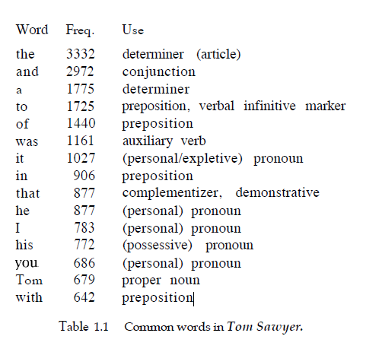
Word Frequency in a corpora
Stop Words / Domain Words
Total tokens – 71K

Slide 5
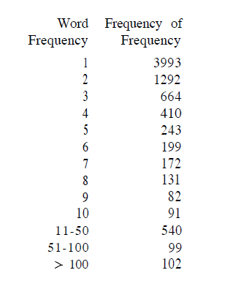
Distribution of words
How many unique words / tokens 🡪 determines the complexity of corpus
How many types of words?
Words appearing only once / twice / …/ten times?
How many times does a word occur in average in this corpus ?

Slide 6
Observations
Word types have a very uneven distribution
Some words are very common, occurring over 700 times and therefore individually accounting for over 1% of the words in the novel
Overall, the most common 100 words account for slightly over half (50.9%) of the word tokens in the text
Almost half (49.8%) of the word types occur only once in the corpus
Handling Sparsity - is the most challenging problem of NLP

Slide 7
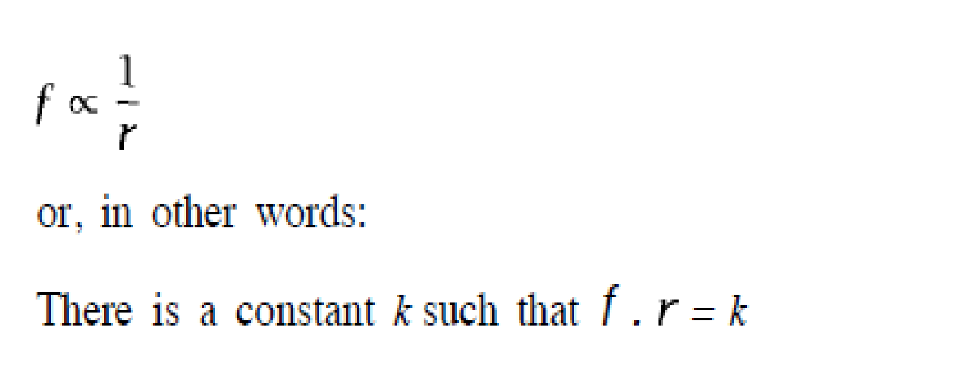
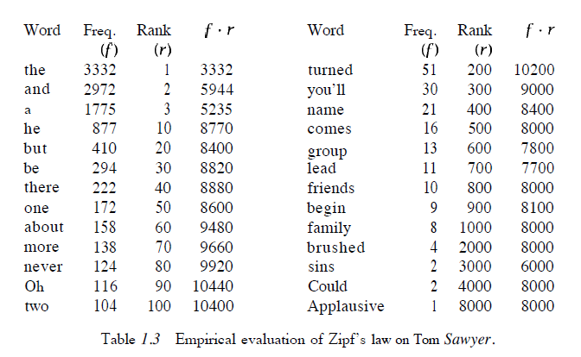
Zipf’s Law (1916)
50th most common word should occur three times more than 150th word

Slide 8
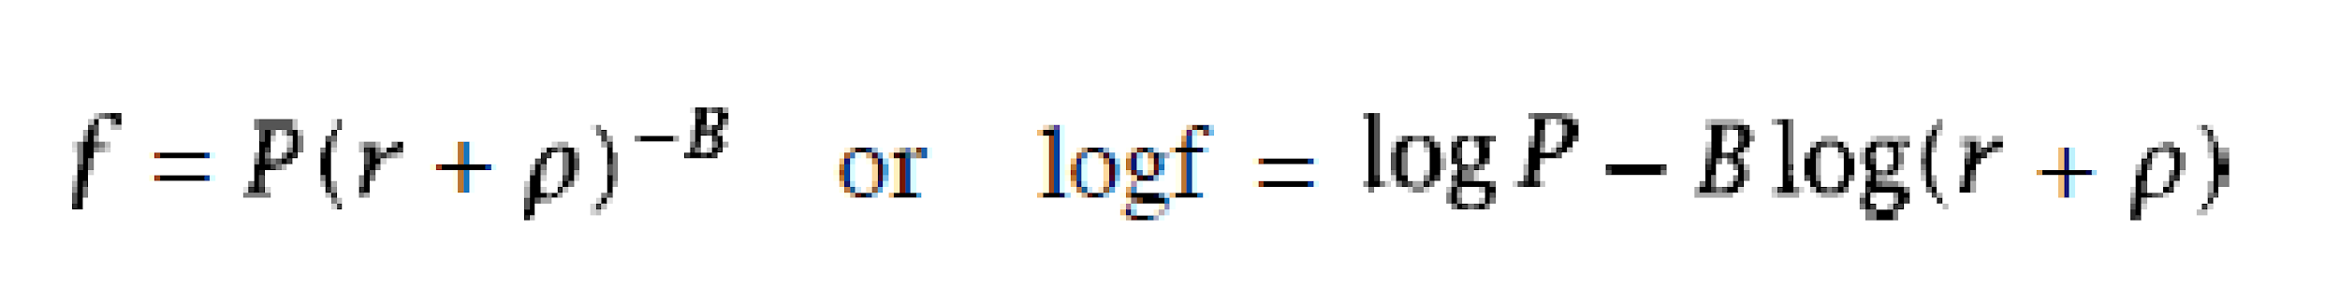
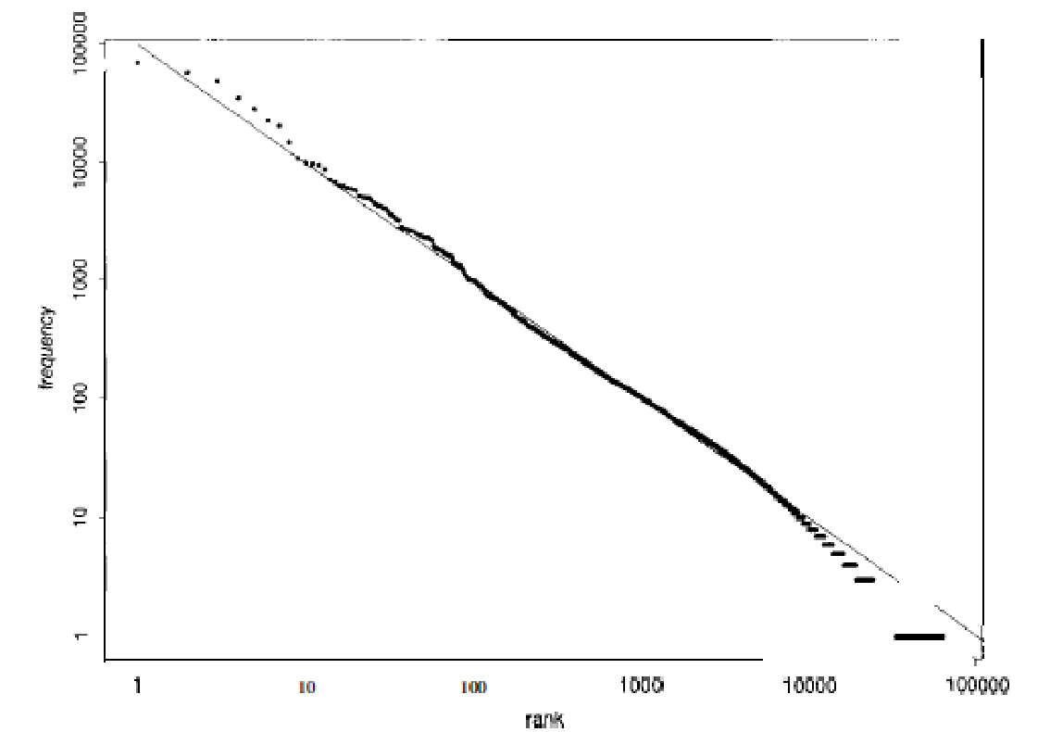
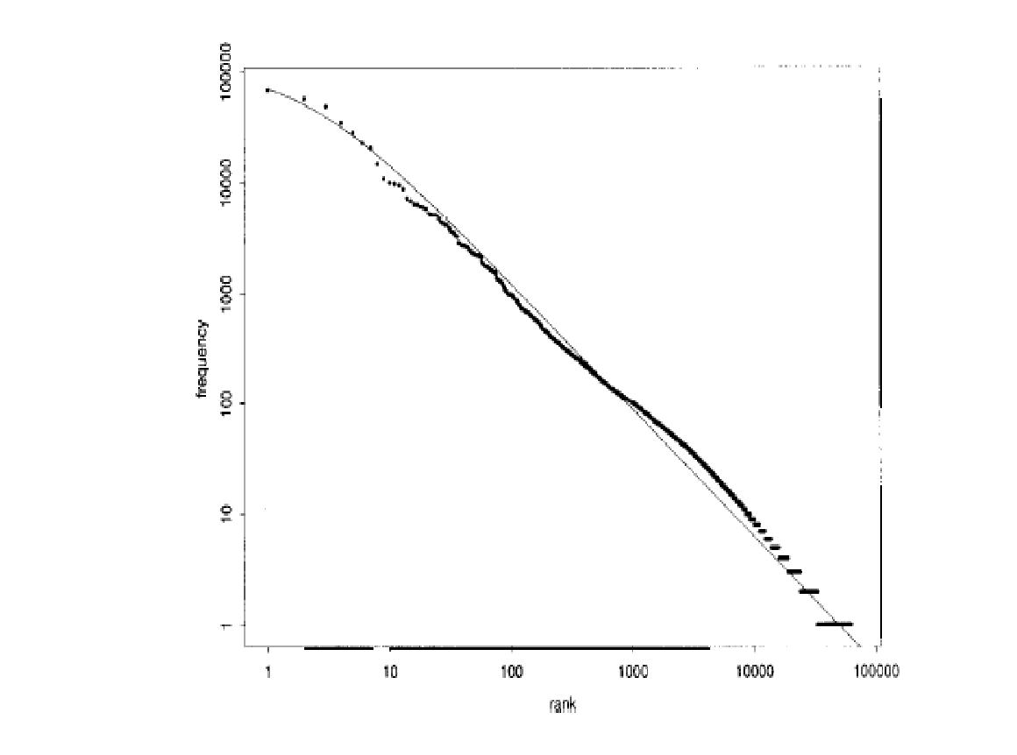
Mandlebrot’s correction (1954)
P, B and ρ are parameters of text
B=1, ρ = 0
P=10^5.4, B=1.15, ρ = 100

Slide 9
Co-occurrence of words
Two words co-occur very frequently after one another
Of the
Class teacher
Show off
I am
Birds fly
Bigrams often determine the nature of a corpus more accurately than word tokens

Slide 10
N grams
The brown fox jumped over the blue moon
2 grams – the brown, brown fox, fox jumped, jumped over, over the, the blue, blue moon
3 grams – the brown fox, brown fox jumped, fox jumped over, jumped over the, over the blue, the blue moon
4 grams – the brown fox jumped, brown fox jumped over, fox jumped over the, over the blue moon

Slide 11
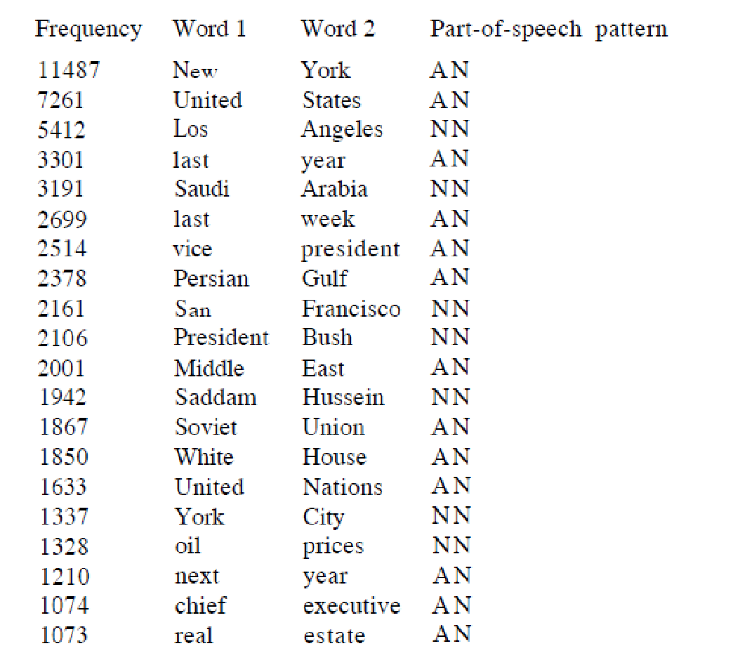
What is the domain?
What is the nature of corpus?

Slide 12
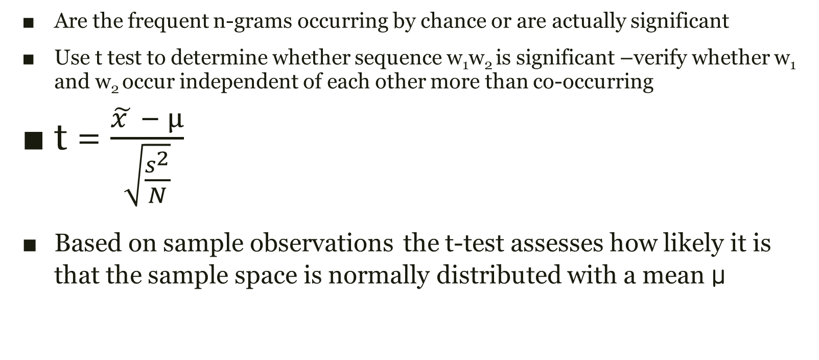
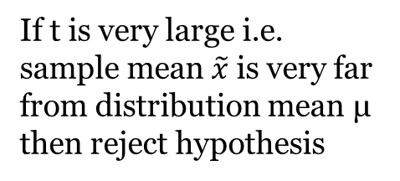
Significance of n-grams

Slide 13
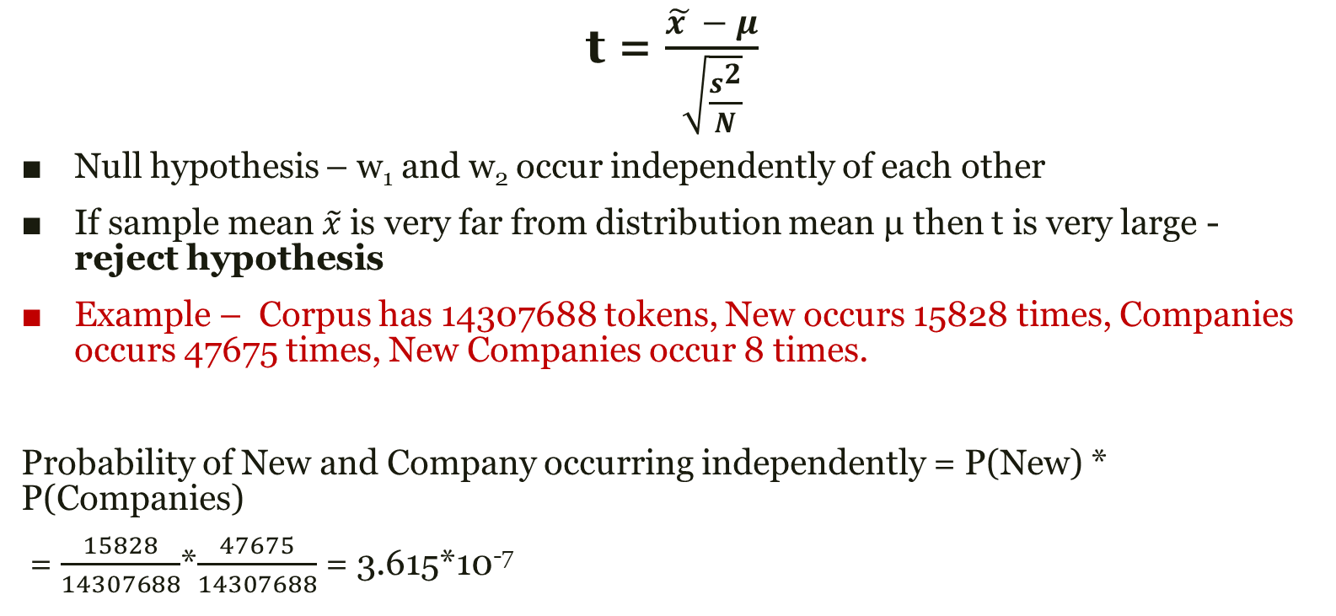
Conducting the t-test

Slide 14
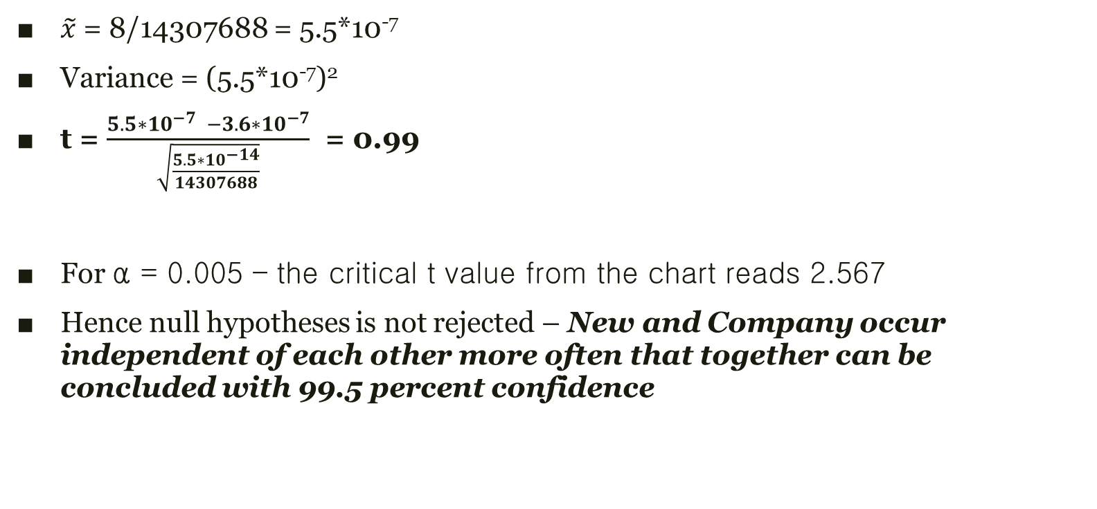
t test

Slide 15
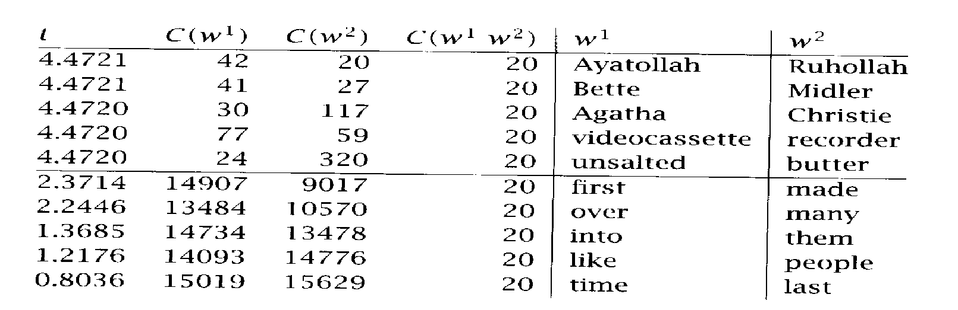
T-values for bigrams from a corpus can help in identification of phrases
Can be helpful in identifying Named Entities for which NERs don’t work very well

Slide 16
Using t-test to predict sequences
Which is better - (w₁w₂) or (w₃w₂)? – for language generation tasks
Powerful drug or Strong drug?
Powerful tea or Strong tea?
Depends on frequencies of
W w₂
W~w₂
~Ww₂
Others

Slide 17
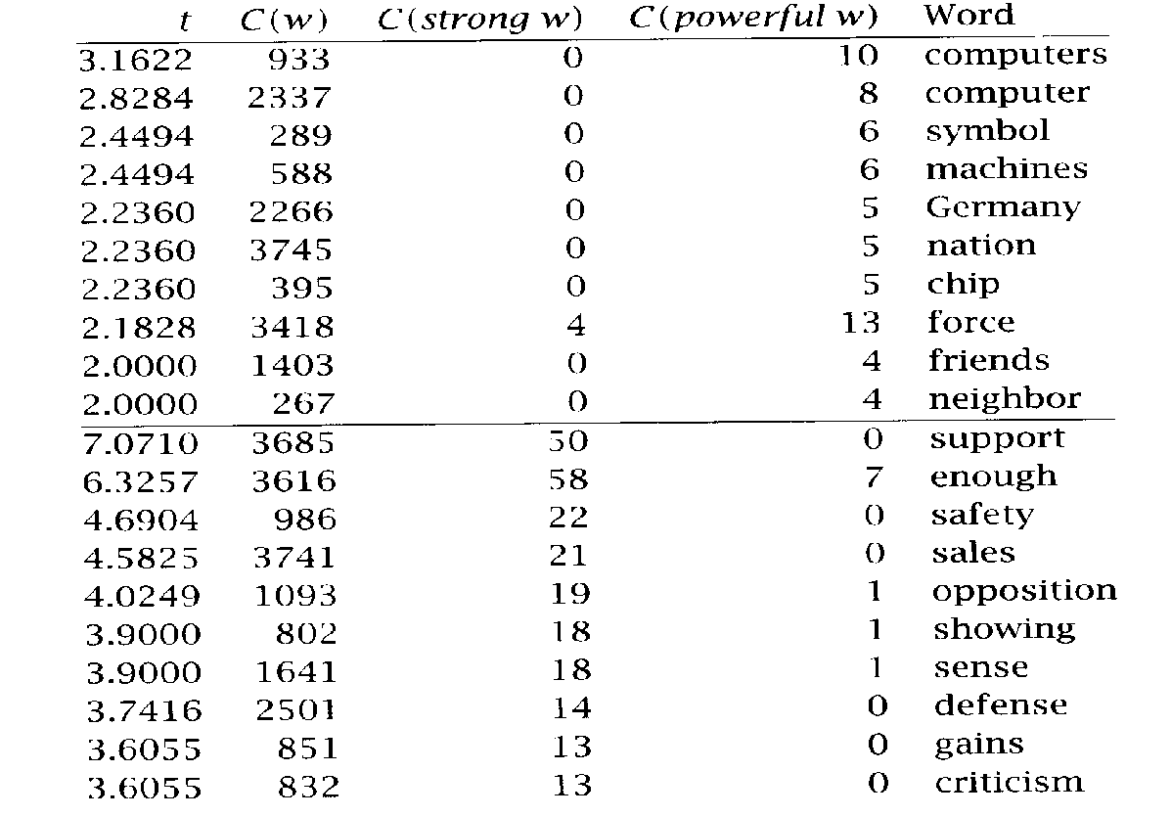
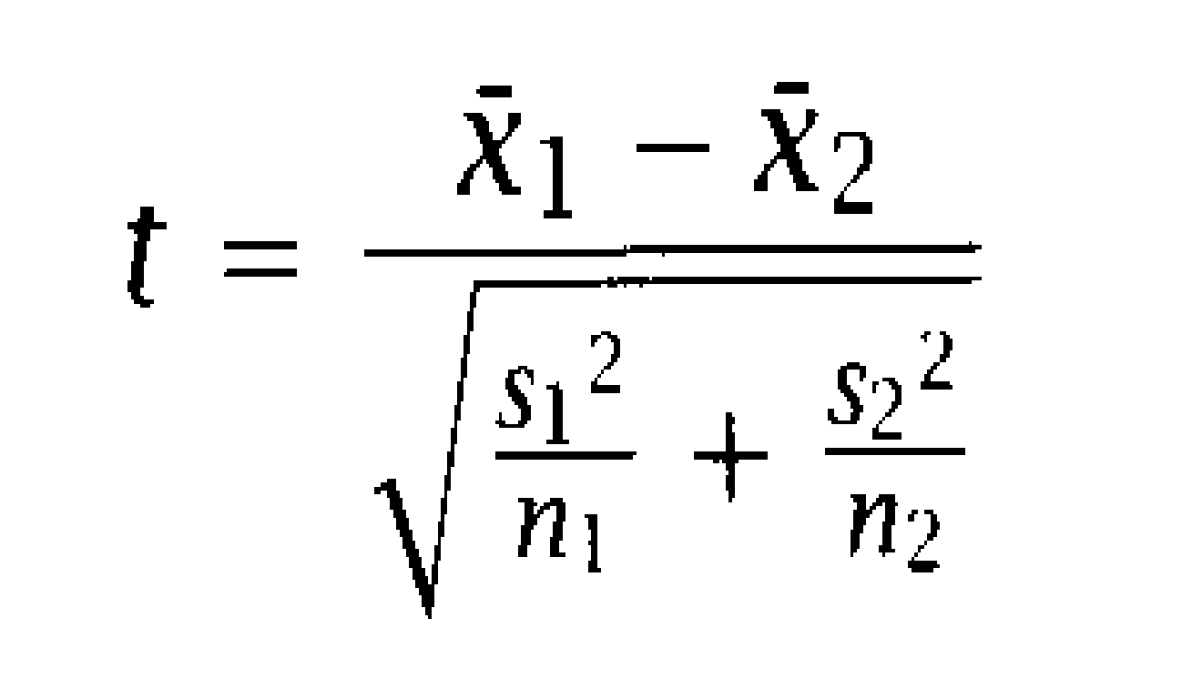
Words co-occurring with strong and powerful
Null hypothesis
For a given word the two earlier words have same mean – i.e. inter-changeable
If it’s really so – numerator will be 0

Slide 18
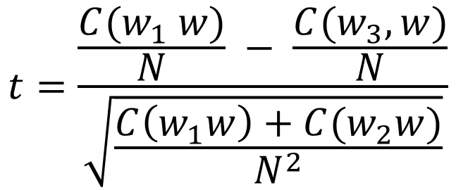
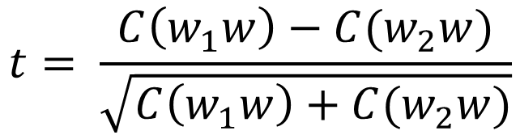
Approximating t to find the right word to replace force
Strong Powerful
Does “powerful” occur more frequently with force? How significant is the difference?
t = (13/3418 – 4/3418)/ sqrt((13+4)/(3418*3418))
= 9 / sqrt(17) = 9/4.2 = 2.18
Null hypothesis - they are same
T-value = 2.18 > 2.06 for 95% confidence interval
Reject the hypothesis - the difference is significant - strong and powerful are not used in the same context for force

Slide 19
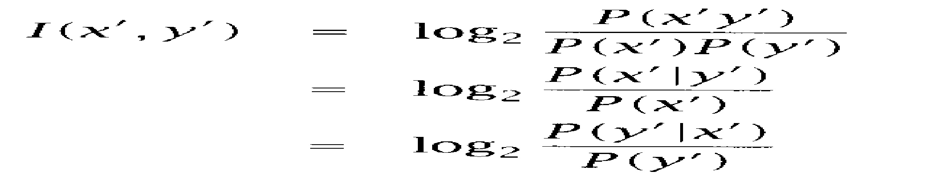
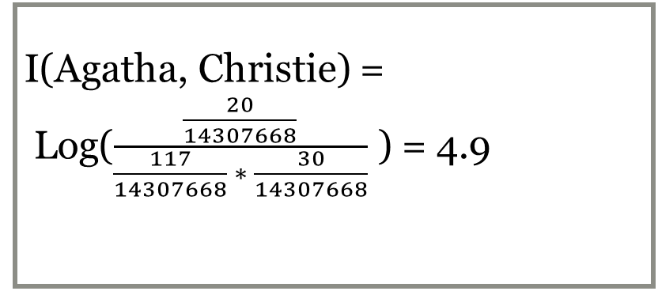
Mutual Information
Used in similar context
How much does one word say about another

Slide 20
Similarity and Dissimilarity
t – test gives us an idea about significance of bigram – w₁w₂ in a corpus
Mutual information tells us – by how much does our confidence about the word in position i+1 increase when we are given the word in position i
Application
Given two News corpus (without the dates) how will you check whether they are talking about similar events?
Given a sentence in English and word and bigram statistics from an English News corpus - how will you select the next word

Slide 21
Collocation
Collocation looks at frequently occurring word combinations
Adjacency – taken care of by ngrams
Knock … door (knocking the door, knocking at the door, knock doors)
Collocations are important
May mean something different from the parts altogether
Passed with flying colors
Frog in my throat
Pain in the neck

Slide 22
LANGUAGE MODELS
Statistical Language Model

Slide 23
Language Models
Inspired by n-grams
Probability of all possible sequences of words
Probability of next word based on previous
● Inspired by
Speech recognition
Optical Character Recognition

Slide 24
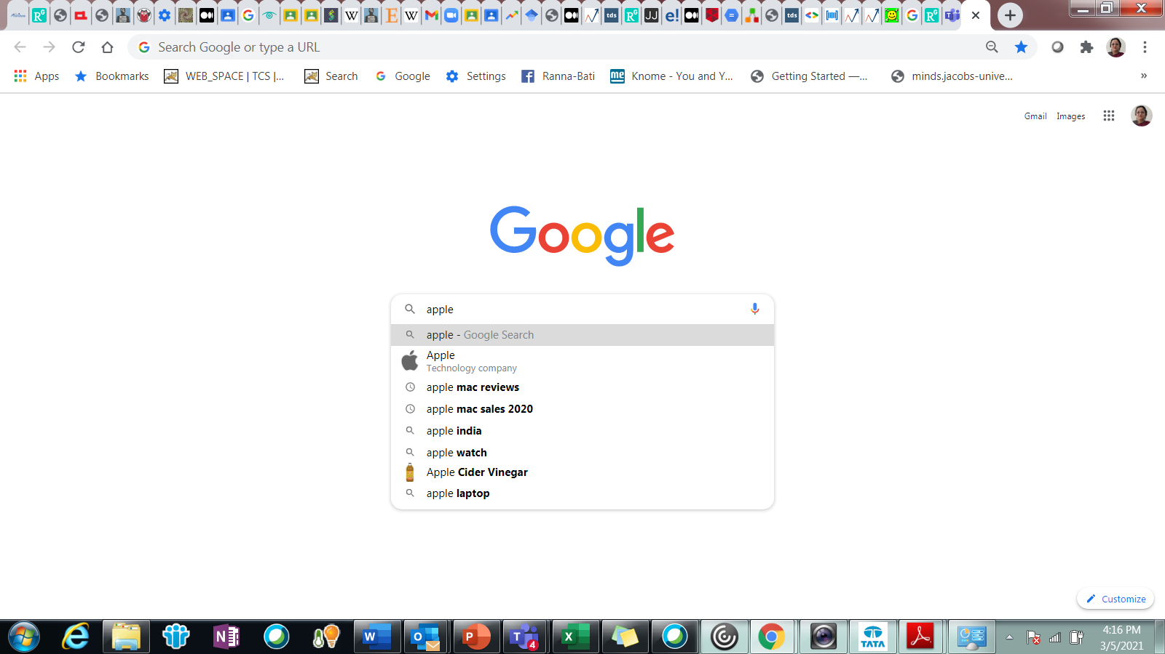
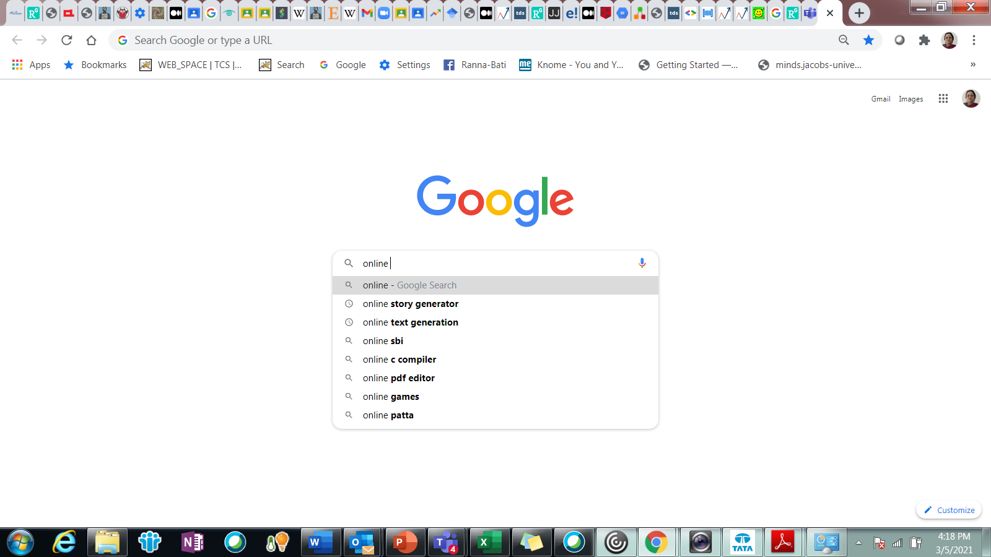
What is the word that follows?
Apple -- ?
Online - ?

Slide 25
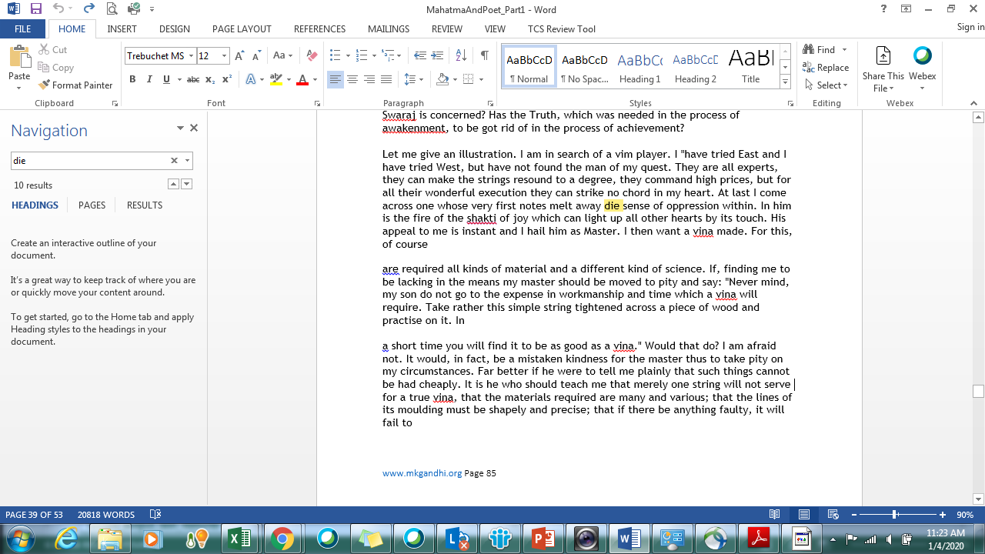
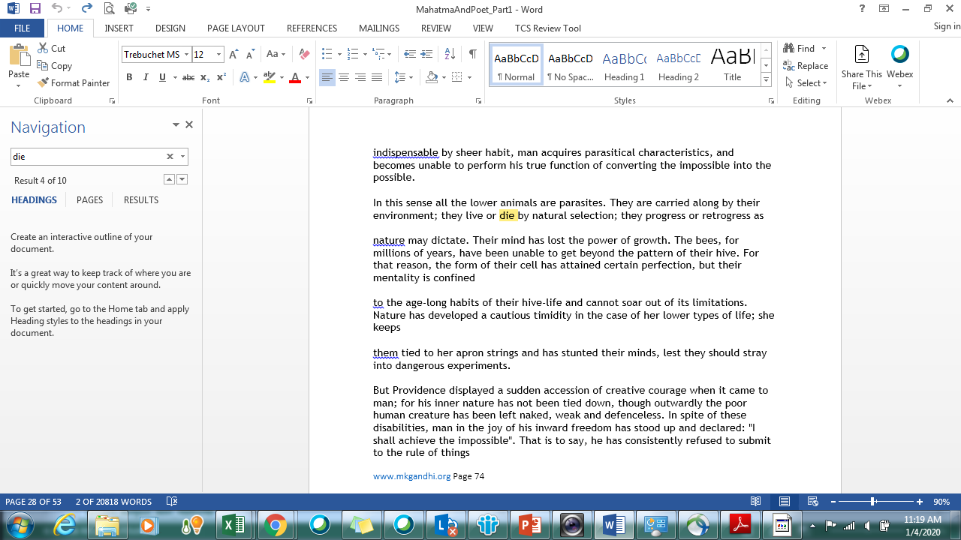
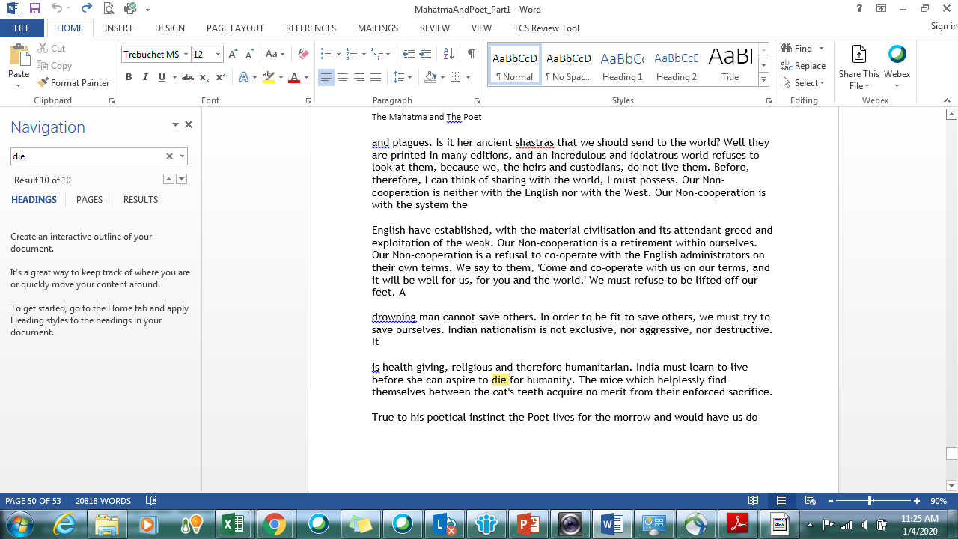
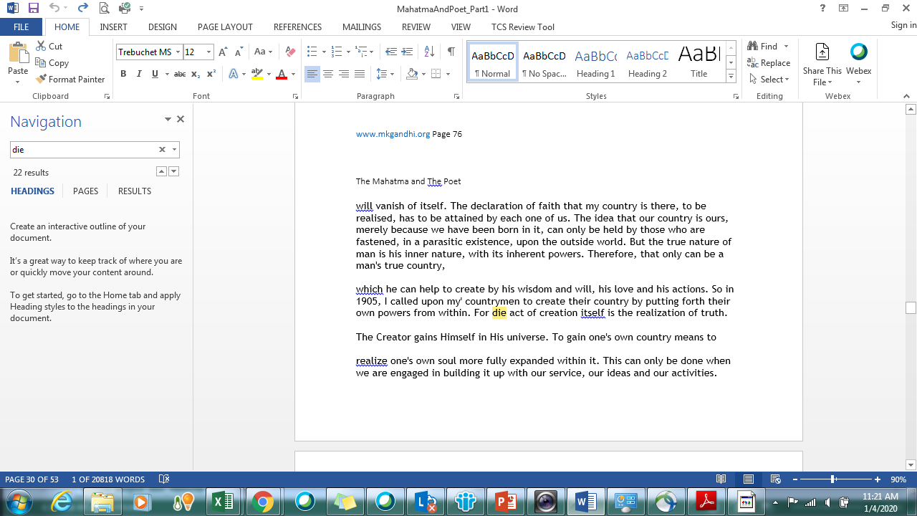
OCR output – Mahatma and the Poet

Slide 26
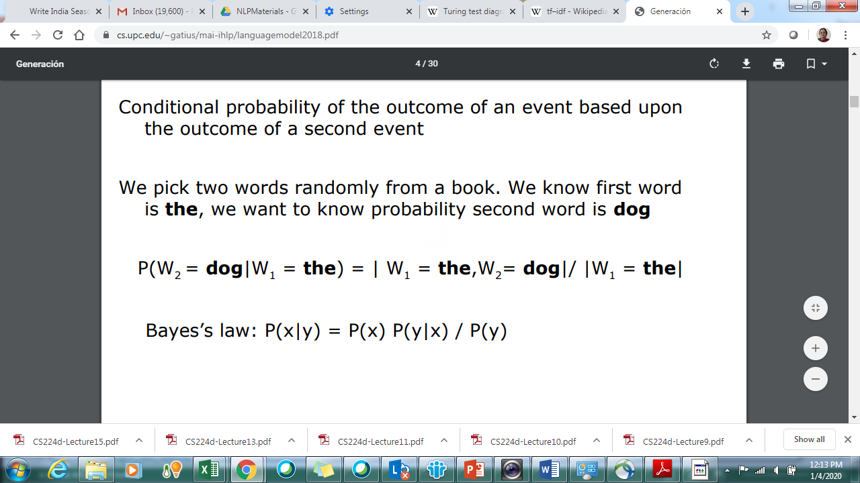
Conditional Probability

Slide 27
Statistical Model of a Language
Vocabulary (V)
Word w ∈ V
Language (L)
Sentence s ∈ L
L ⊂ V* usually infinite
s = w₁ ,…w_{N}
Probability of s =P(s)
Find P(S = W_{1,n}= <w_{1,n}>) where w_{1,n} is a sequence of words

Slide 28
Probability of a sequence
Compute probability of sequences - P(w₁ ,w₂ ,..,w_{n} )
Decompose using the chain rule of probability
P(w₁ ,w₂ ,..,w_{n} ) =P(w₁ )P(w₂ |w1 )P(w₃ |w₁ ,w₂),… P(w_{n} |w₁ ..,w_{n-1})
Markov assumption : we can predict the probability of some future unit without looking too far into the past

Slide 29
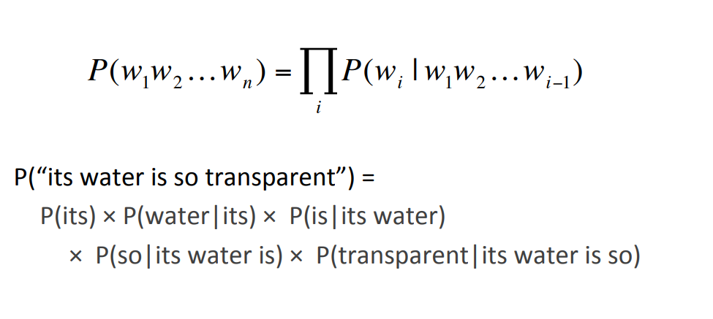
Example

Slide 30
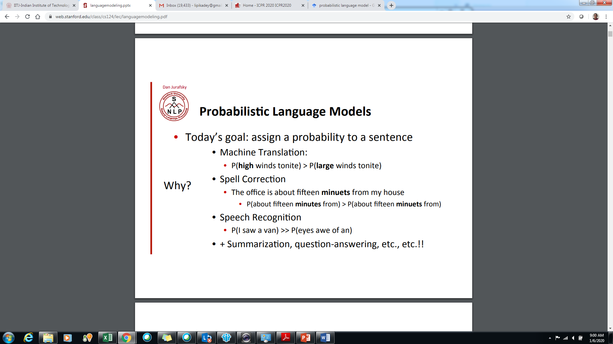
High probability sequences

Slide 31
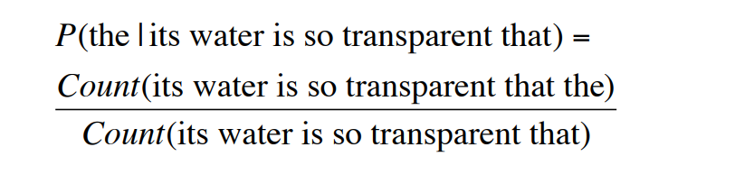
Estimating probabilities from corpus
Estimate from counts in corpus
P(w₁w₂…w_{n}) = Count_of (w₁w₂w₃…w_{n}) / Count_of (w₁w₂w₃…w_{n-1})
P(its water is so transparent that the) =
Impossible to get enough data

Slide 32
Predicting words to complete sequences
Given a sequence w₁w₂w₃…w_{n-1} – predicting next word w
Predicted word w = Maximum_Likelihood_EstimateP(w|w₁w₂w₃…w_{n-1})
Without enough data to compute probabilities – models are meaningless

Slide 33
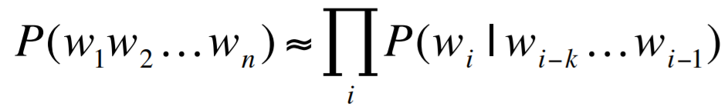
Ngram Models
Markovian Assumption – Not all n-1 previous words are required – limited data from the past can be used
Unigrams consider only one past word
P(w₁w₂w₃w₄) = P(w₂|w₁)*P(w₃|w₂)*P(w₄|w₃)
Bigrams consider only two past words
P(w₁w₂w₃w₄) = P(w₃ |w₁ w₂) * P(w₄|w₂w₃)
Trigrams consider only three past words
P(w₁w₂w₃w₄)= P(w₄ |w₁w₂w₃)

Slide 34
Experiment
Green –
Large Green –
I swallowed a large green –
Pro
The more information you have – the better is your prediction
Con
Sparseness of data - few words are common - vast majority of words are
very uncommon
Longer n-grams are rarer
MLE assigns a zero probability to unseen events.

Slide 35
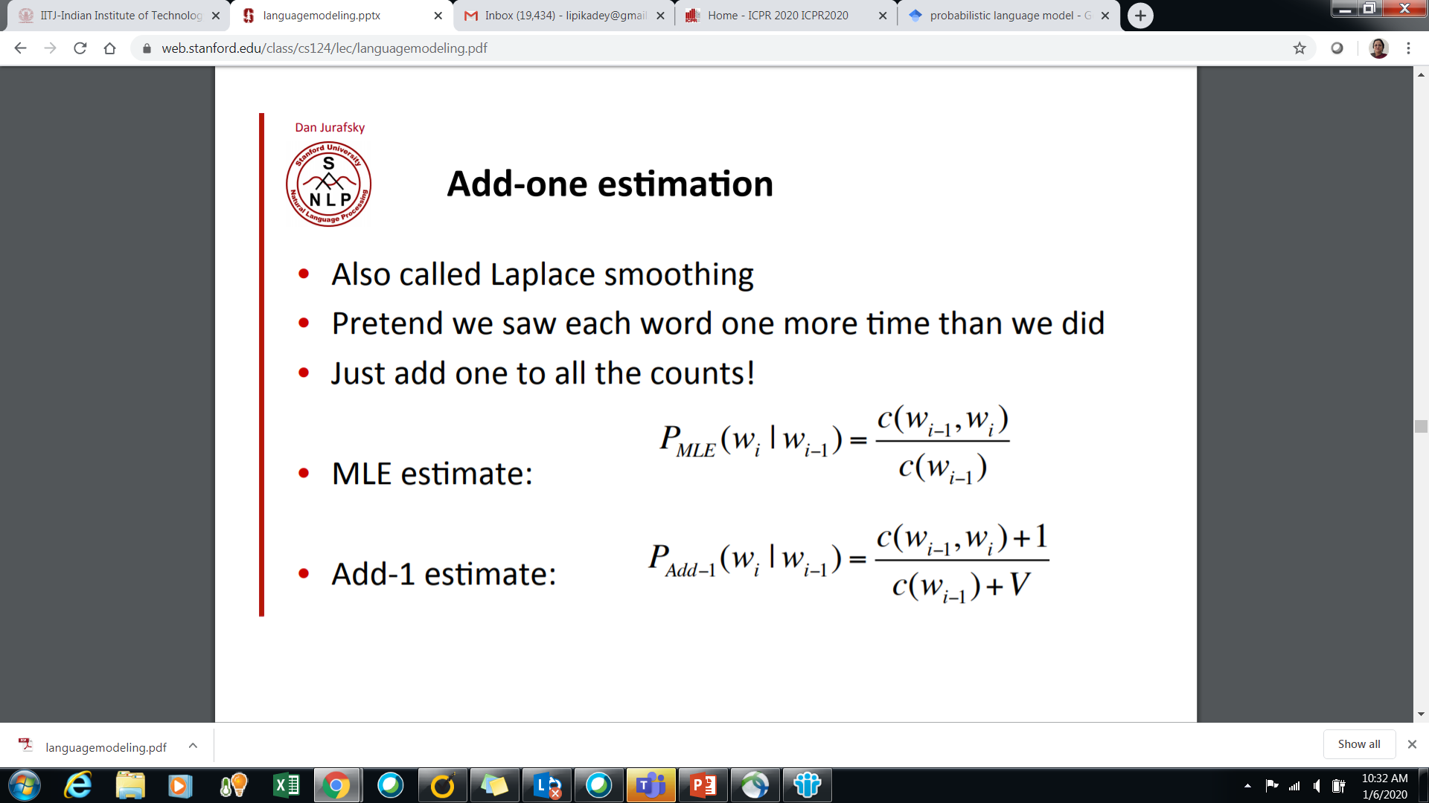
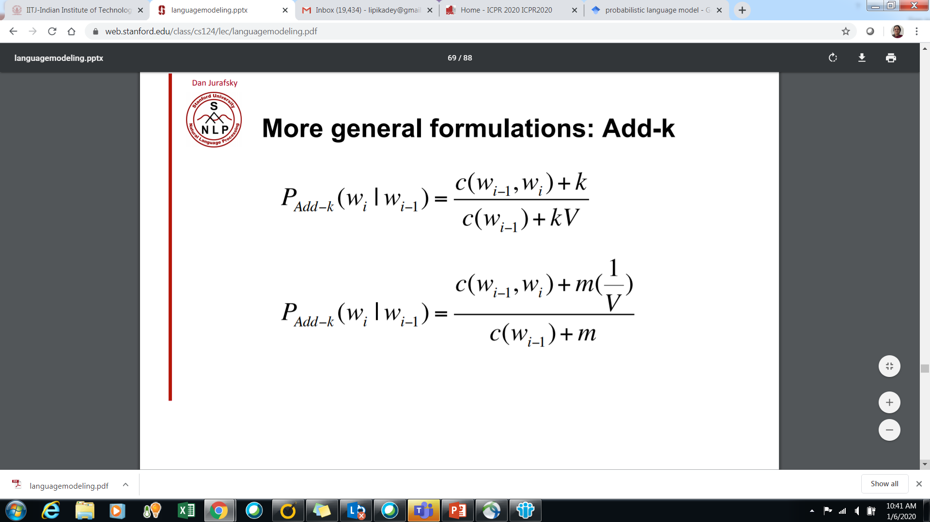
Laplacian smoothing

Slide 36
Can we use this to Disambiguate –i.e. Remove ambiguity
Word sense disambiguation
I can’t bear this stress any more ------The bear lost its life in bushfire
She rose to the occasion ----------- He gave a rose to her
The bank is a nice place for an evening stroll -----The bank has no money.
I am hungry (food) ---------- I am hungry (knowledge/power)
I love baking (act) cake ---- I love chocolate (adjective) cake
I liked the title (description) music of the movie – this story has no title (noun)
Anaphora / Coreference resolution – disambiguate
I introduced Anna to Ryan. Though an Indian, she (Anna) is a resident of France. She speaks ---- very fluently.

Slide 37
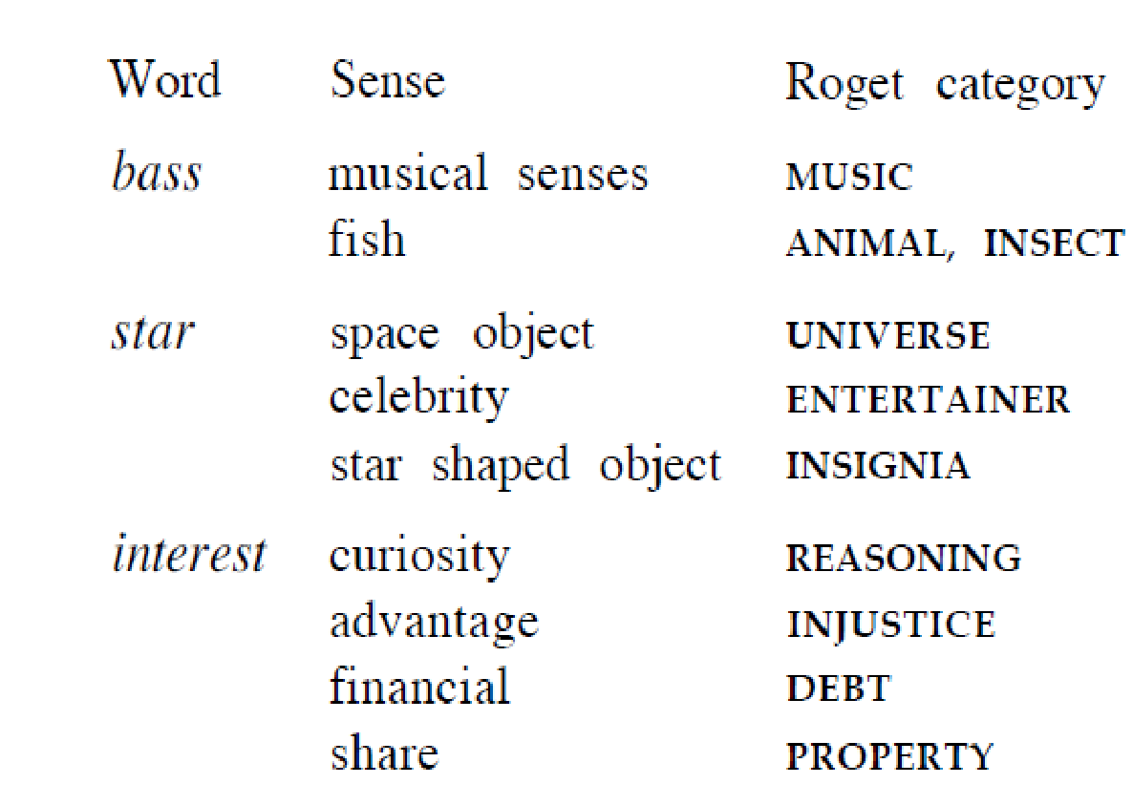
Digital Thesaurus
A resource that is built from a large corpus - using statistics and partial annotations by people

Slide 38
WordNet - https://wordnet.princeton.edu/
WordNet® is a large lexical database of English. Nouns, verbs, adjectives and adverbs
Grouped into sets of cognitive synonyms (synsets), each expressing a distinct concept
Synsets are interlinked by means of conceptual-semantic and lexical relations
The resulting network of meaningfully related words and concepts can be navigated with the browser
WordNet is also freely and publicly available for download.
WordNet's structure makes it a useful tool for computational linguistics and natural language processing.

Slide 39
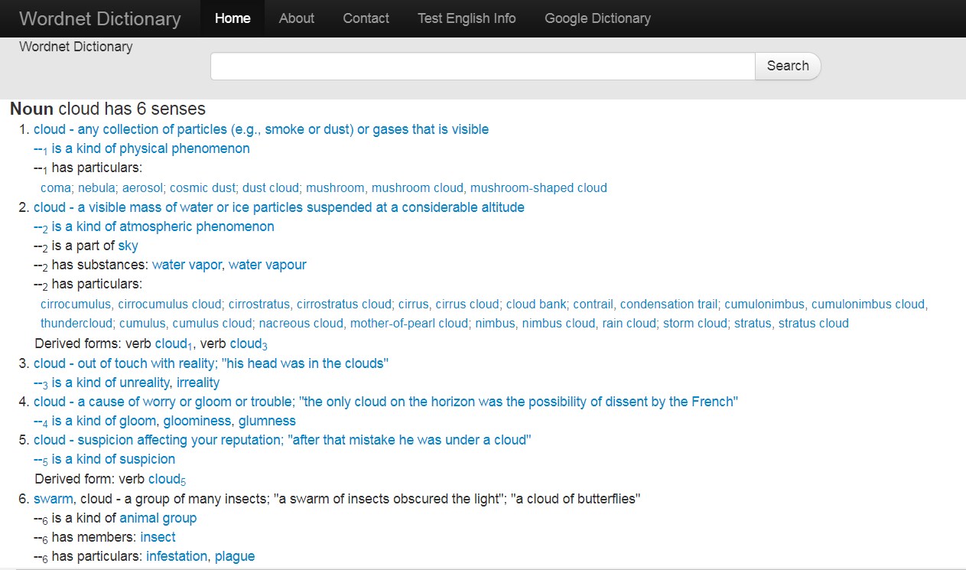

Slide 40
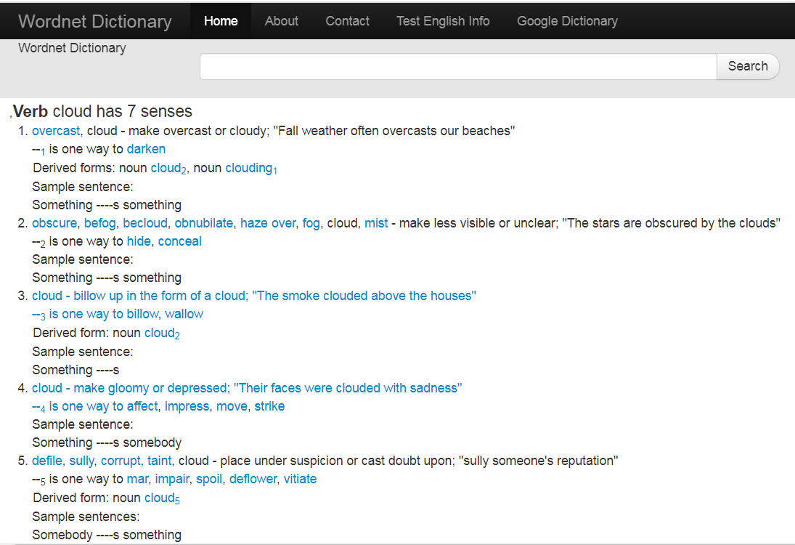

Slide 41
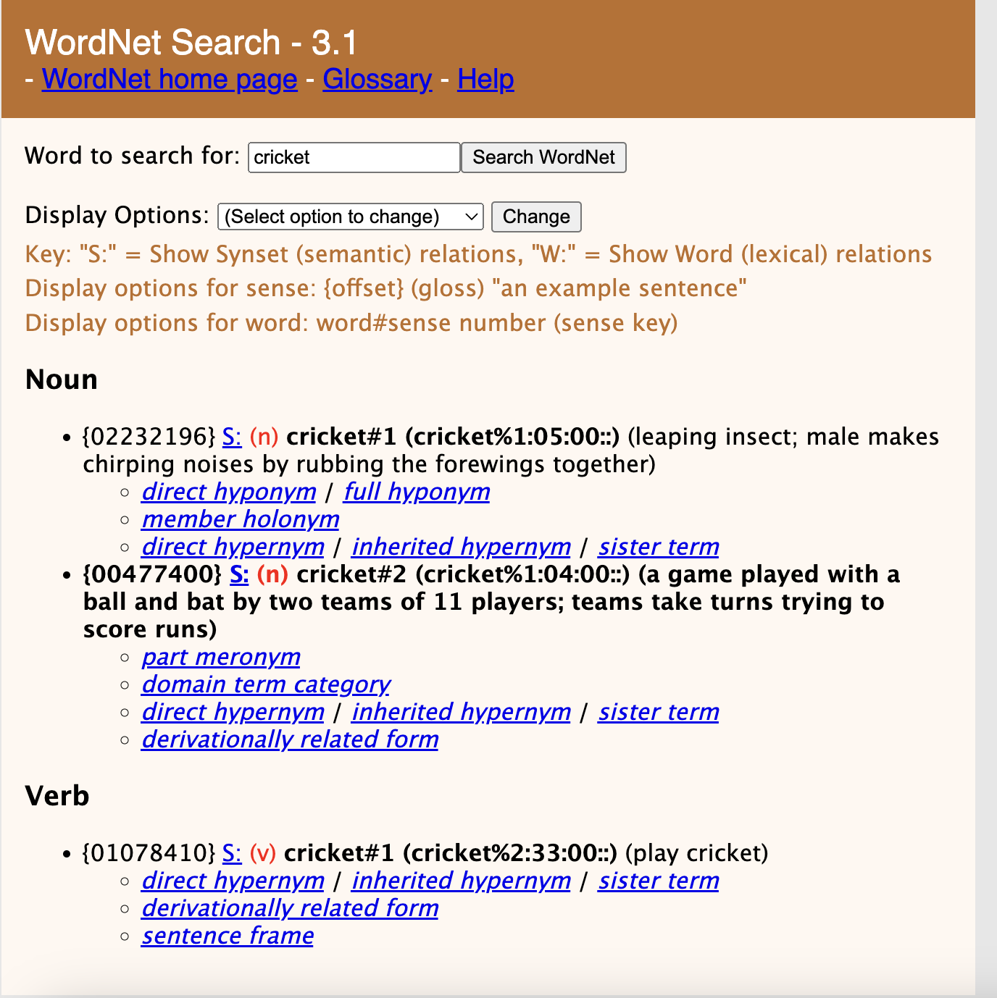
Wordnet Online (available for download)
The thesaurus can now be used for sense disambiguation of other corpus

Slide 42
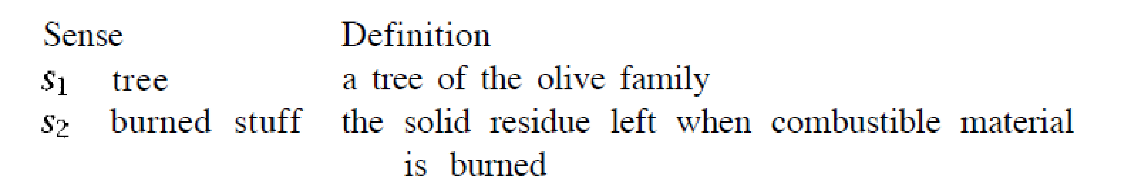
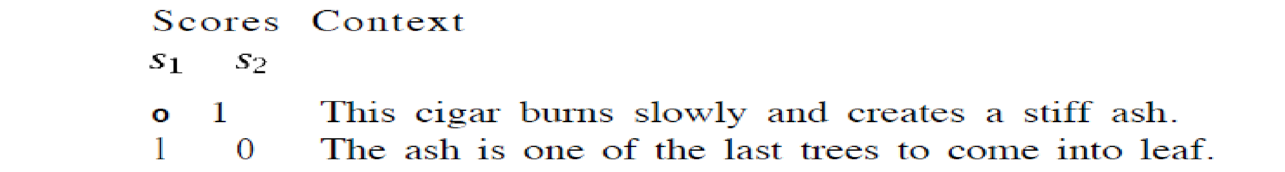
Thesaurus based Disambiguation
Word – Ash
This cigar burns slowly and creates a stiff ash.
The ash is one of the last trees to come into leaf.
Dictionary
Compute Overlap of context with dictionary definition (lesk’s algorithm)

Slide 43
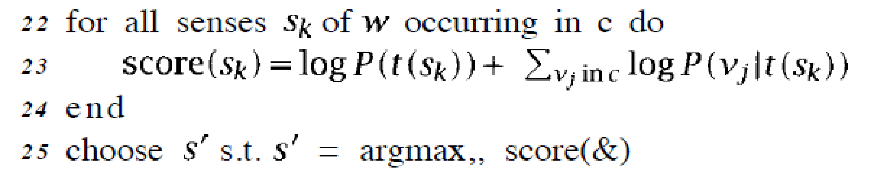
Disambiguation
Achieves higher accuracy
Can disambiguate new words
Context is also known as discourse

Slide 44
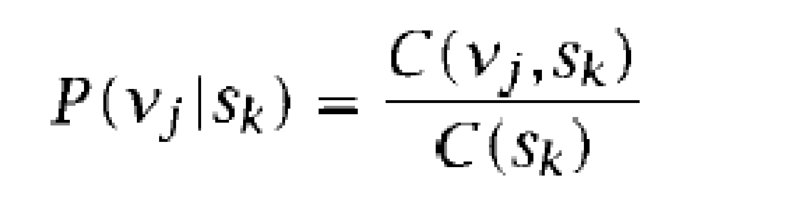
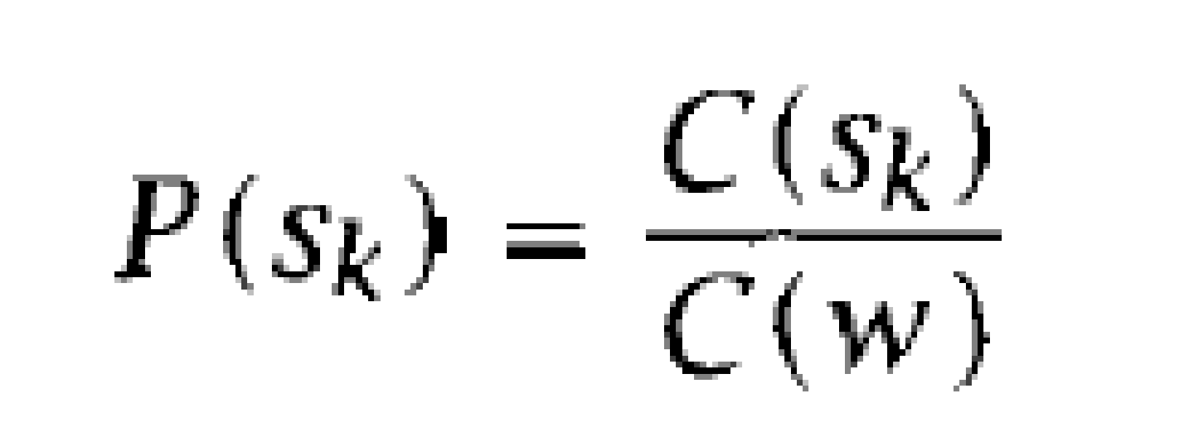
Example - Drug
C(v_{j}, s_{k}) = Number of times word v_{j} occurs in the context s_{k} of word w
Context1 – prices, prescription, patent, increase, consumer, pharmaceutical
Sense - Medication
Context2 – abuse, paraphernalia, illicit, alcohol, cocaine, traffickers
Sense – Illegal Substance
C(s_{k}) = Number of times context s_{k} occurs in corpus
C(w) = Number of times word w occurs in corpus

Slide 45
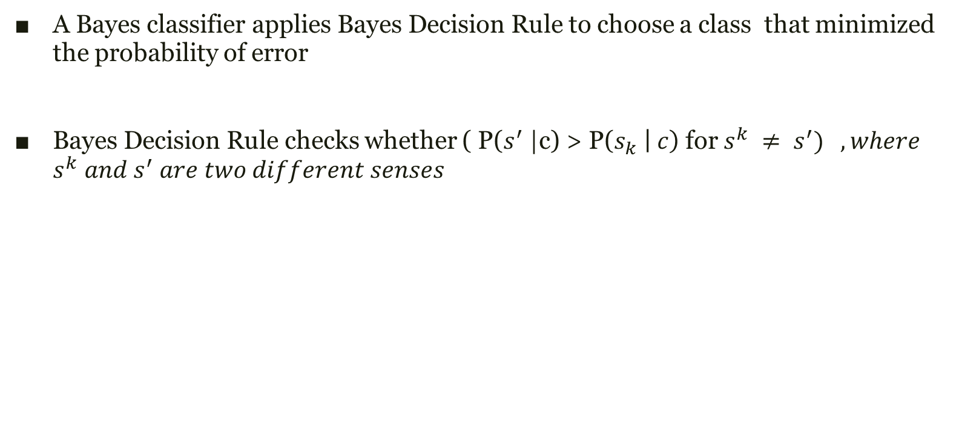
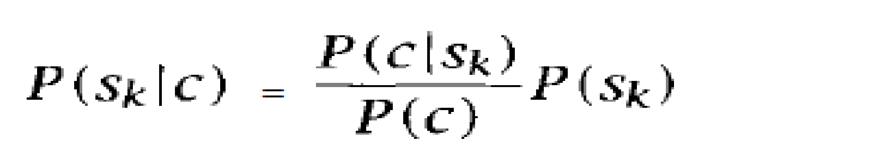
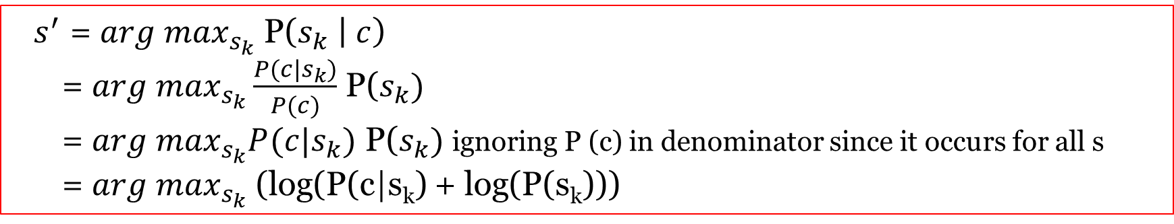
Bayes Classifier
Compute
Sense Decision

Slide 46
Naïve Bayes assumption
All words in context contributes independently
No order is assumed – Bag of Words model

Slide 47
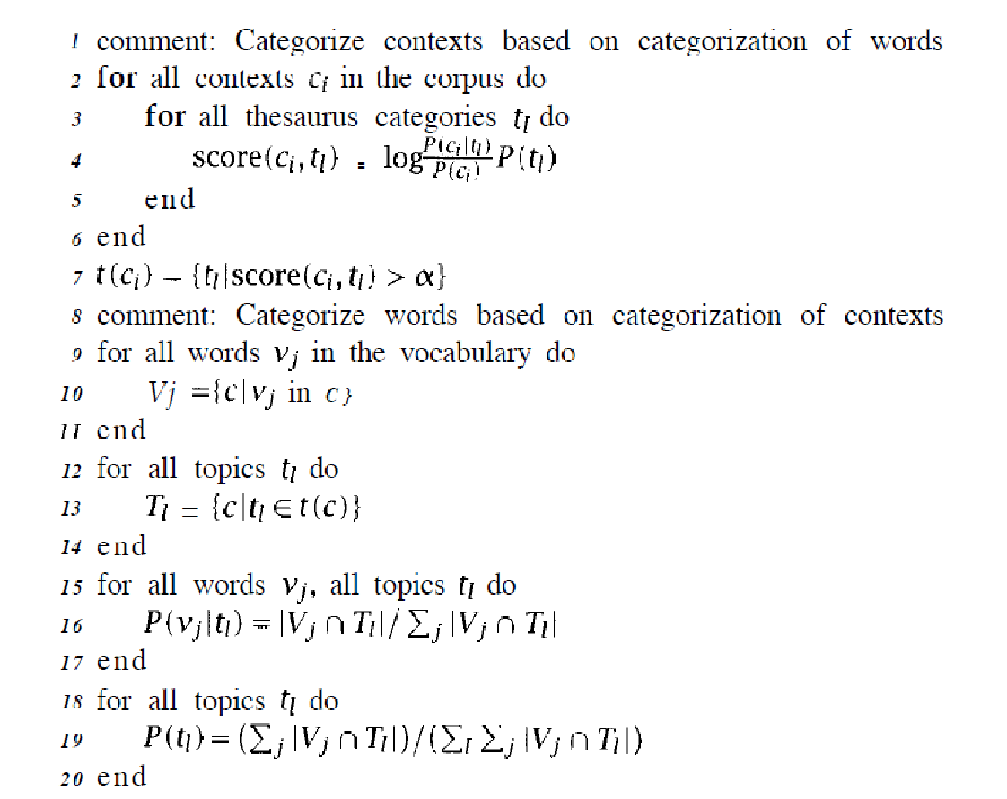
Adaptive Thesaurus based Sense Disambiguation
Computing Context – Sense attachment score
For all words – assign Thesaurus category score
A word may have multiple thesaurus category score
For all Thesaurus category – obtain all context
For all Thesaurus category – obtain word score based on above context
P(Thesaurus category)

Slide 48
Machine Learning
To deal with new words - new context - ambiguous context
Let w be an ambiguous word
Let S₁ ,..., S_{k} ,..., S_{n} denote the senses of the ambiguous word w
Let C₁,..,C_{i}, . . . . C_{m} be the contexts of w in a corpus – a collection of K words surrounding the word to be disambiguated
Let v₁,...,v_{j},...,v_{M} be the words used as contextual features for disambiguation
Supervised Methods
Assume the existence of a completely disambiguated corpus
Learn to disambiguate based on that

Slide 49
Supervised Tasks in NLP
Sense disambiguation
Sentiment Analysis
Event detection
Named Entity Recognition

Slide 50
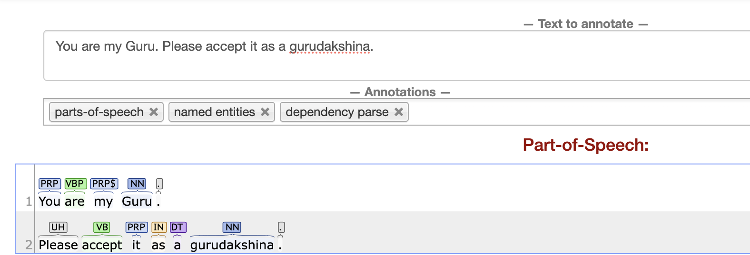
Can existing tools parse new words correctly?
Though word is not known - POS tag is correct

Slide 51
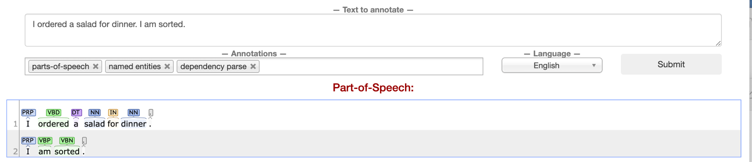
Language evolves - new use of old words
Is “sorted” a verb here?

Slide 52
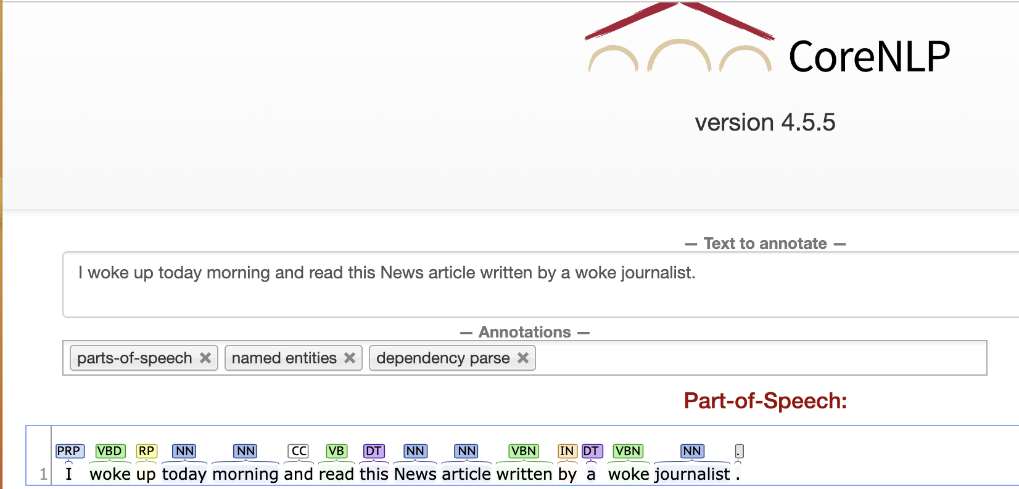
Two “woke”s are not same

Slide 53
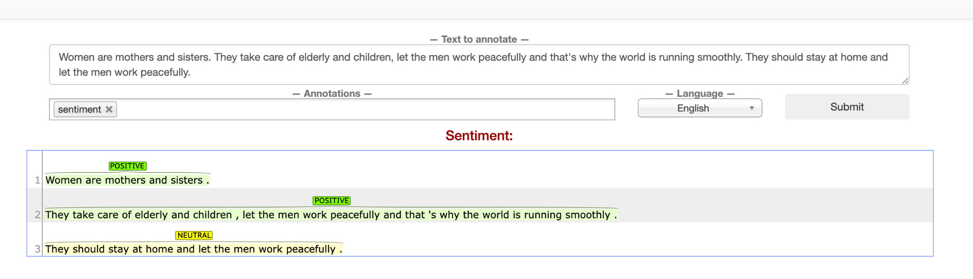
Sentiment Analysis is a particularly difficult task - needs world knowledge

Slide 54
Supervised Machine Learning for Text Analysis
Need large volumes of “annotated” data for learning
Text with “new” words, “new contexts”
Text with labels
Build new models for prediction (of POS tags, Sentiment, Intent, News labels/relevant for a query, etc…)
Evaluate models - how good is it?
N-fold Cross validation
Training and Test splits

